Slide 1

Introduction to Data Science Lecture 1 - Introduction
All Sessions will be recorded and placed to Moodle, but participation is mandatory for credit.
Ph.D. Vahan Sargsyan

Slide 2
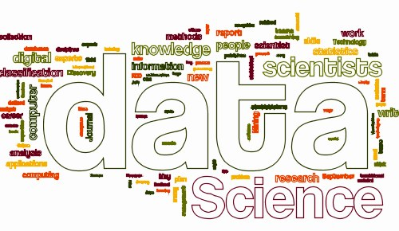
Welcome to Introduction to Data Science!
One of the most demanded professions in 21st century, and its popularity increases with the introduction of AI.

Slide 3
About the Course
Course Materials, dates and Announcements:
Check the Moodle page
Course Instructors:
Check the Moodle page
Course rules, policies and grading:
Check the Syllabus

Slide 4
Course Outline
Course Outline:
Introduction
Key Notations and Definitions
Working with Data
Fundamental Algorithms (Logit, Random Forest, Ensemble Models)
Analytics and Evaluation
Course Materials (Check the Moodle Page):
Burkov, A. (2019). “The Hundred-page Machine Learning Book”.
PPT presentations
Datasets
Practical Sessions – Python scripts

Slide 5
Data Science as a Profession
Statistics and Mathematics
Probability, algebra, regression, etc.
Choose procedure
Diagnose problem
Coding
Databases
Tools, programing languages
Field-specific knowledge
Experience in field
Goals, methods and constraints
Statistics and Mathematics
Machine Learning
Traditional Research
Coding
Data Science
Field-specific knowledge
(Domain)
Danger Zone

Slide 6
What is Machine Learning?
Term coined by Arthur Samuel (IBM) in 1959
Machines doing things without being explicitly programmed to do so.
Algorithm that is able to do two consecutive steps:
Find a pattern in a Data;
Make a prediction based on the found pattern.
Human Learning is very similar:
X1 | X2 | X3
2 | 5 | 12
4 | 2 | 8
4 | 3 | 10
3 | 1 | ?

Slide 7
What is Machine Learning?
Term coined by Arthur Samuel (IBM) in 1959
Machines doing things without being explicitly programmed to do so.
Algorithm that is able to do two consecutive steps:
Find a pattern in a Data;
Make a prediction based on the found pattern.
Human Learning is very similar:
1*2 + 2*5 = 12
1*4 + 2*3 = 10
1*4 + 2*2 = 8
1*X1 + 2*X2 = X3
? = 5
X1 | X2 | X3
2 | 5 | 12
4 | 2 | 8
4 | 3 | 10
3 | 1 | ?

Slide 8
What is Machine Learning?
Term coined by Arthur Samuel (IBM) in 1959
Doing things without being explicitly programmed to do so.
Algorithm that is able to do two consecutive steps:
Find a pattern in a Data;
Make a prediction based on the found pattern.
Human Learning is very similar:
-2*5 + 1*12 = 2
-2*3 + 1*10 = 4
-2*2 + 1*8 = 4
-2*X2 + 1*X3 = X1
? = 5
X1 | X2 | X3
2 | 5 | 12
4 | 2 | 8
4 | 3 | 10
3 | 1 | ?

Slide 9

Disadvantages and Advantages of Machine Learning
Disadvantages:
Slightly distorted inputs →completely wrong output
Advantages:
The computing force of the machine → May reveal non-ideal functional form of the relationship.
(1*)X1 | (+2*)X2 | (=)y
2 | 5 | 12
4 | 2 | 8
4 | 3 | 10
3 | 1 | 5
(1*)X1 | (+2*)X2 | (-0.5*)X3 | (=)y
2 | 5 | 4 | 10
4 | 3 | 6 | 7
4 | 2 | 2 | 7
3 | 1 | 10 | 0
6 | 3 | 2 | 11
(+)error | (=)Y
-1 | 9
+0.6 | 7.6
-0.8 | 6.2
+0.4 | 0.4
+1 | 12

Slide 10

Advantages of Machine Learning
The computing force of the machine.
What if:
the functional form of the relationship is not ideal;
the provided data is not complete.
(1*)X1 | (+2*)X2 | (-0.5*)X3 | (=)Y
2 | 5 |  | 9
4 |  |  | 7.6
4 | 2 |  | 6.2
 | 1 |  | 0.4
6 | 3 |  | ?

Slide 11
Econometrics and Regression
Econometrics is the application of statistical methods to economic data in order to give empirical content to economic relationships (i.e. find patterns).
In statistical modeling, regression analysis is a set of statistical processes for estimating the relationships between a dependent variable and one or more independent variables.
Some regression models (most common):
Logit;
Random Forest;
Ensemble Models – combination of multiple models/multiple model types
Neural Networks and Deep Learning.

Slide 12
Data Science and Machine Learning
Research for an appropriate Regression model – ±5%;
Data Mining and Cleaning – ±80%;
Trial and improvement, retrial and improvement, … - ±15%
Machine learning is a continuously evolving system based on the new data and corrections of the past predictions.
Python as a programming Language for ML.

Slide 13



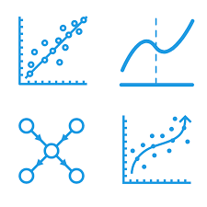

This course
Planning
Data Gathering
Data Cleaning
Modeling
Analytics and Evaluation

